Slide 1
Role of Various Stakeholders in Promoting Digital Wellness
Gowramma I P RIE NCERT Bhubaneswar
Online programme on digital wellness
CIET, NCERT
gowriip@gmail.com

Slide 2
Few anecdotes
Steve Jobs in 2010 was on the stage at the Apple event releasing the iPad and he described it as a wonderful device that brought you educational tools. It allowed you to surf the web, it allowed you to watch videos, it allowed you to interact with other people. And he basically said it’s the best way to do all those things.
Two years later when he was asked “Your kids must love the iPad?” He said “Actually we don’t allow the iPad in the home. We think it’s too dangerous for them in effect.”

Slide 3
Sharing
My kids get limited computer time,” he said. “Just because you’re the daughter of Bill Gates does not mean you get to play on your computer all day long.”
Gates, who also held off on providing his kids with cell phones until they turned 14, said he also set a time that his kids had to stop using computers to help them get to sleep at a reasonable hour. He looks for ways to balance technology for learning and social interaction while recognizing the perils of overindulgence.

Slide 4
The Background
We rely on technology not just for learning but for everything
Technology can enhance both life and education
It can ruin and damage beyond measure
Instil healthy habits right from the beginning
Responsibility of elders to help succeed and thrive in the digital world
We have a responsibility to help our younger generation to distinguish between healthy and unhealthy digital use.

Slide 5
Policy Perspective on Cyber Safety and Security
NEP 2002 emphasizes that ‘Children and adolescents enrolled in schools must not be forgotten in this whole process; after all, the school system is designed for them. Careful attention must be paid to their safety and rights’ (Para 8.11).
Notes:
The global digital boom has transformed the way we interact for everyday transactions, especially in India. Businesses, government, non-government entities, healthcare and the education sector have all been impacted in one or many ways with digital solutions substituting legacy processes.
Source: Technology and cyber trends in the Indian education sector

Slide 6
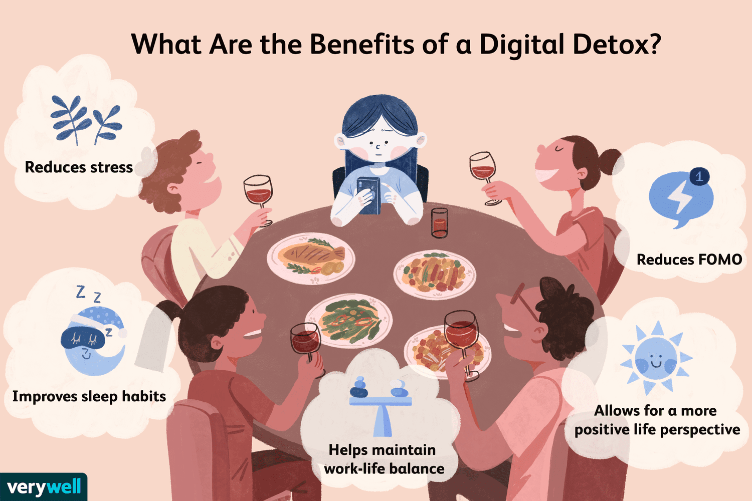

Slide 7
Digital Wellness
Ability to take a mindful approach while interacting with technology.
Use digital tools with responsibility.
Care for physical and mental health in digital environment.
Youngsters may be digital natives but do not know healthy technology use
They pick up digital skills quickly but lack the skill of using it in a healthy way

Slide 8
“In the realm of education, cyber safety is not an add-on but an integral part of providing a holistic and secure learning environment that prepares students for the challenges of the digital age.”

Slide 9
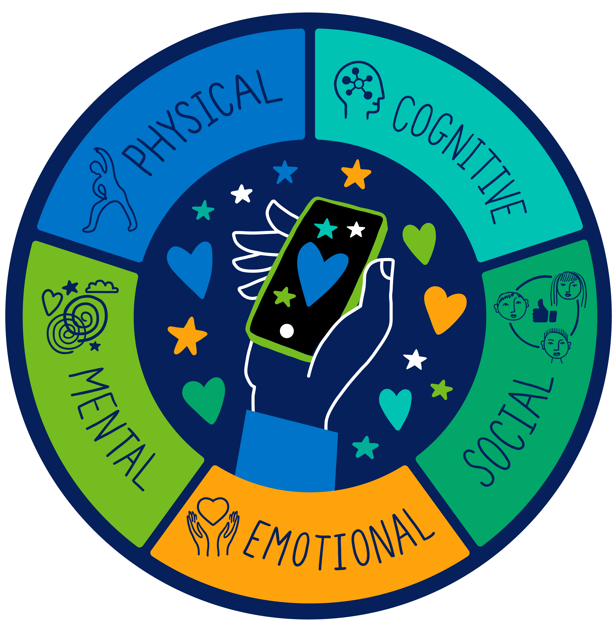
What can we do?
Converse with students on consequences of spending long hours online
Prompt self reflection with strategic questions
Research has revealed that teens express that they are spending too much time on their cell phones
While talking to teenagers on digital wellness use positive perspective
Instead of saying the must not and should not, look at ways of empowering them
Discuss not just on less screen time but on more positive online experiences

Slide 10
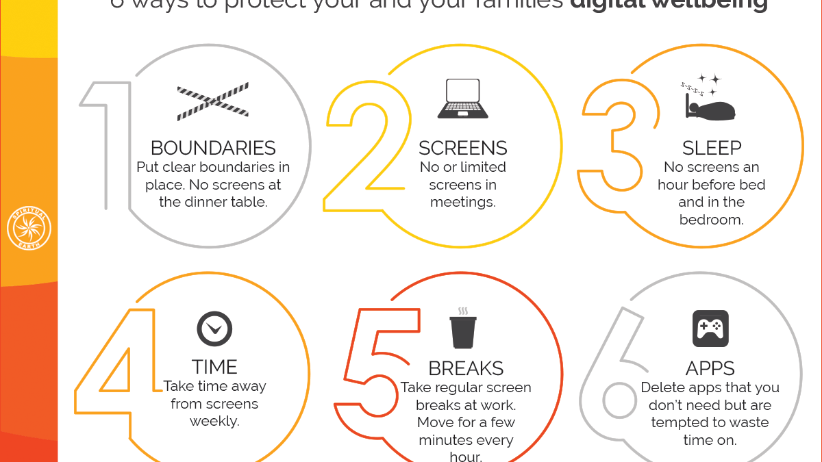

Slide 11
Digital Wellness Extends Beyond Classroom
Introduce the concept of “Device free dinner”, “digital detox”
Information guide to care takers
Encourage offline activities
List the activities you see in the picture and suggest more

Slide 12
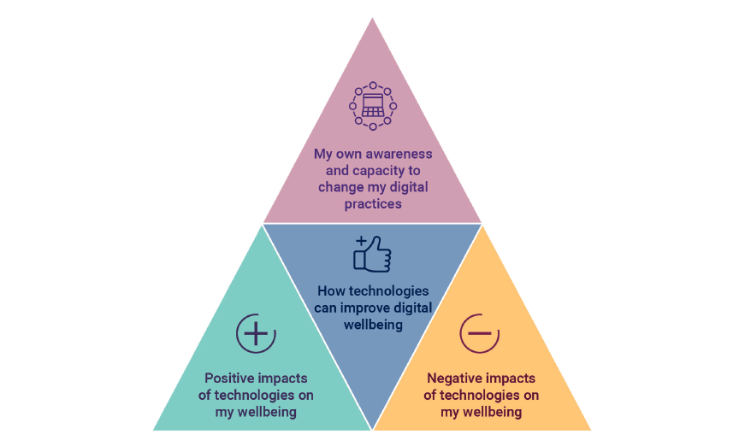
ACTIVITY II

Slide 13
Various Stakeholders in Promoting Digital Wellness
Educational Institutions
Teachers
1
2
Parents and Guardians
Mental Health Professionals
3
4
Peer Students
5

Slide 14
I have these episodes deep in me, so added……………
After a decade designing technologies meant to address education, health, and global poverty, award-winning computer scientist Kentaro Toyama came to a difficult conclusion: Even in an age of amazing technology, social progress depends on human changes that gadgets can't deliver.
Kentaro Toyama is a computer scientist and international development researcher, who works on the relationship of technology and global development. He is the W. K. Kellogg Professor at the University of Michigan School of Information. and author of Geek Heresy: Rescuing Social Change from the Cult of Technology

Slide 15
Initiatives to Promote Digital Wellness
MANODARPAN – an initiative by Ministry of Education (MOE), Government of India (GOI) aims to provide psychosocial support for mental health and well-being of students.
National Toll-free Helpline (8448440632) has been set up to provide tele-counselling to students across schools, colleges and universities and their parents and teachers to address their mental health and psychosocial issues.
Sahyog’ live interactive sessions are held every day for students(classes VI-XII) from 5-5:30 pm on PM e-vidya channel with the focus on providing guidance for promoting mental well-being among students.

Slide 16
PRAGYATA, Guidelines on digital education was prepared by NCERT.It also focuses on Physical, mental health and wellbeing during digital education.
Main emphasis is on balanced online and offline activities keeping the screen time as an essential parameter in accordance with the level of students.
It provides Do’s and Don’ts regarding ergonomics and Cyber safety, ethical practices including precautions and measures for maintaining Cyber Safety.

Slide 17
Final Word
Establish clear rules
Talk about healthy online behaviour
Be aware of the content children are viewing
Encourage positive habits
Teach digital safety
Create awareness on digital scams, online bullying and other dangers of the digital world

Slide 19
Role of Educational Institutions
Awareness Campaigns: Run campaigns to raise awareness about the importance of digital wellness.
Curriculum Integration: Incorporate digital literacy and responsible technology use into the curriculum.
Provide Guidance: Offer guidelines and policies for responsible technology use within the institution.
Teacher Professional Development: Educate teachers on digital wellness principles and strategies.
Mental Health Services: Offer counseling and support for students facing digital addiction or related mental health challenges.

Slide 20
Role of Teachers
Setting Boundaries: Establish classroom rules for technology use.
Role Modeling: Demonstrate responsible online behavior.
Cyberbullying Prevention: Educate students about online harassment and provide support.
Digital Well-Being Check-Ins: Regularly check in with students about their online experiences.
Promote Offline Activities: Encourage students to engage in non-digital pursuits.
Resource Sharing: Provide tools and resources for managing screen time and stress.
Collaboration with Parents: Maintain communication with parents about digital well-being.
Referral to Support Services: Refer students to appropriate support services if needed.

Slide 21
Role of Parents and Guardians
.
Stay Informed: Parents should educate themselves about digital technologies and their impact on children's well-being in order to be better prepared to guide and protect children online.
Setting Boundaries: Establish clear rules and limits for screen time and technology use at home. Establish digital device curfews to ensure a healthy sleep routine.
Role Modeling: Demonstrate responsible technology use and healthy digital habits.
Open Communication: Foster open and non-judgmental communication with children about their online experiences.
Monitoring: Supervise children's online activities and use parental control tools when necessary.
Teach Digital Etiquette: Instill the importance of respectful and ethical online behavior.
Support Offline Activities: Encourage and engage children in offline activities, hobbies, and social interactions.
Be Aware of Cyberbullying: Be vigilant for signs of cyberbullying or online harassment and offer emotional support.

Slide 22
Role of Mental Health Professionals
Assessment: Evaluate individuals for digital addiction or mental health issues related to excessive screen time.
Counseling and Therapy: Provide counseling and therapeutic services to address digital addiction and related mental health challenges.
Digital Detox Support: Assist individuals in implementing digital detox plans when necessary.
Awareness Campaign: Educate clients about the potential negative effects of excessive screen time on mental health.
Support Groups: Facilitate support groups for individuals facing digital wellness challenges.
Collaboration: Collaborate with educators, parents, and community organizations to address digital wellness holistically.
Customized Treatment: Tailor treatment plans to address individual needs and circumstances related to digital wellness.

Slide 23
Role of Peer Students
Peer Support: Offer support and understanding to fellow students facing digital challenges.
Education: Share information and resources about responsible technology use and digital wellness.
Role Modeling: Demonstrate positive and balanced digital habits as an example to others.
Promote Offline Activities: Encourage peers to engage in offline activities and social interactions.
Digital Well-Being Clubs: Form or join clubs or groups focused on promoting digital wellness within the school community.
Peer Workshops: Facilitate workshops or discussions on topics related to digital well-being.
Supportive Listening: Be a listening ear for peers who want to discuss their online experiences or concerns.
Advocate for Safe Spaces: Advocate for creating safe and inclusive online and offline spaces within the school environment.

